Slide 1
School System
UML Project

Slide 2
Team Members
Mina Alphonse
Ahmed Samir
Mostafa Fathy
Mohamed Hussien
Ahmed ElTohamy

Slide 3
Star-UML
StarUML is a UML tool by MKLab. The software was licensed under a modified version of GNU GPI until 2014, when a rewritten version 2.0.0 was released under a proprietary license.
After being abandoned for some time, the project had a revival to move from Delphi to Java, before stopping again. Meanwhile, an unaffiliated community fork was created under the name of WhiteStarUML. In 2014, the original developers rewrote StarUML and released it as Shareware under a proprietary license.
Notes:
- MkLab is a Korean software company.
GNU GPL is a series of widely used free software licenses that guarantee end users the 4 freedoms to run, study, share, and modify the software.

Slide 4
Star-UML cont.
The stated goal of the project was to replace larger, commercial applications such as Rational Rose and Borland together.
StarUML supports most of the diagram types specified in UML 2.0. Since version 4.0.0 (October 29 2020) it includes timing and interactions overview diagrams.

Slide 5
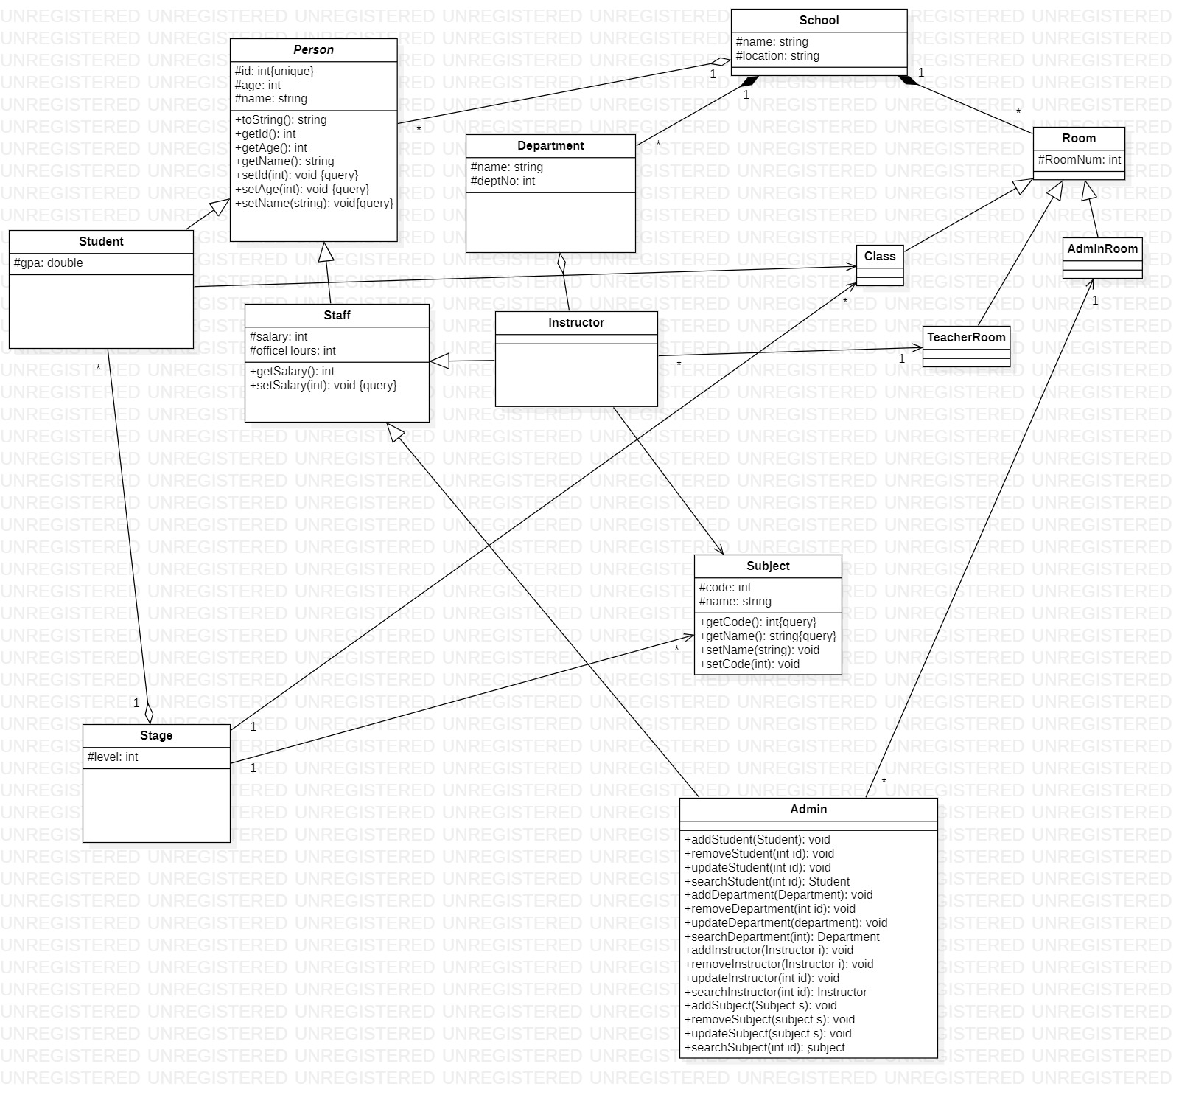
Class Diagram

Slide 6
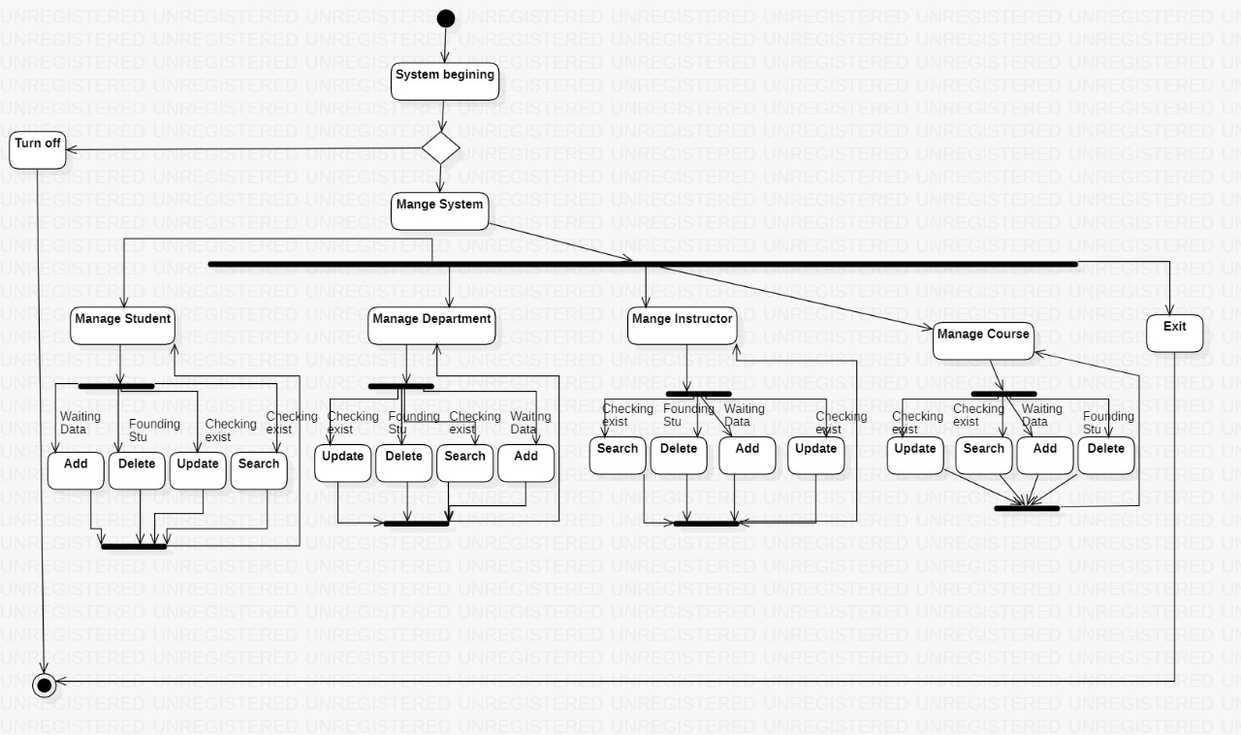
State Diagram

Slide 7
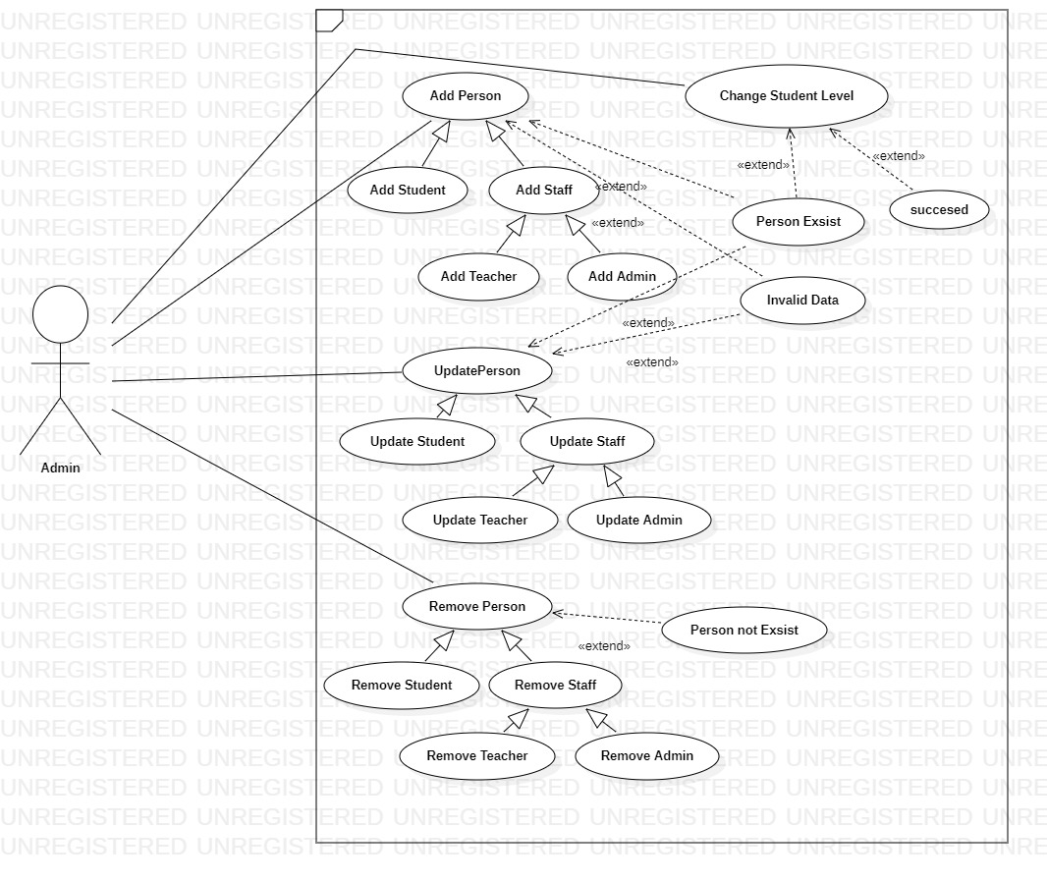
Use-Case Diagram

Slide 8
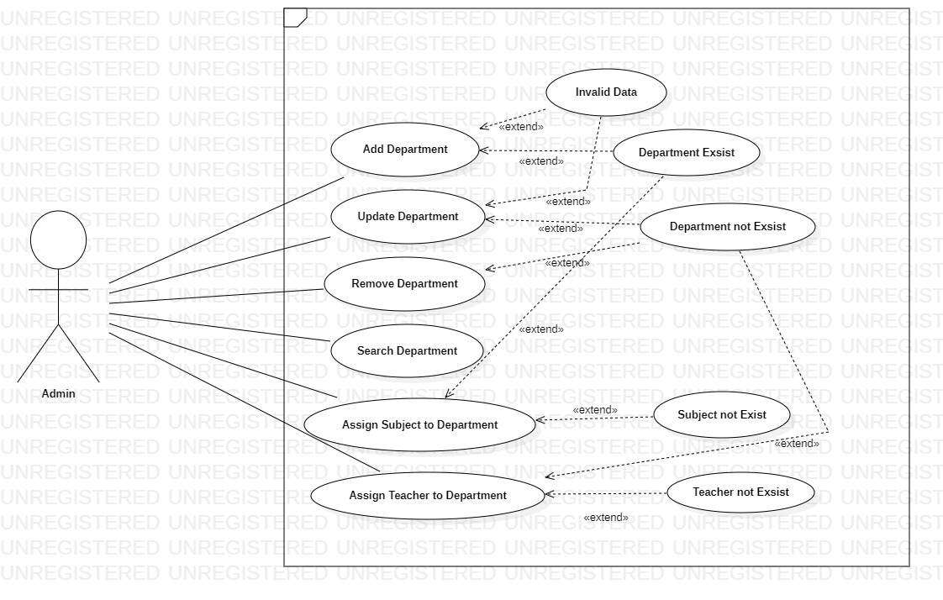
Use-Case Diagram cont.

Slide 9
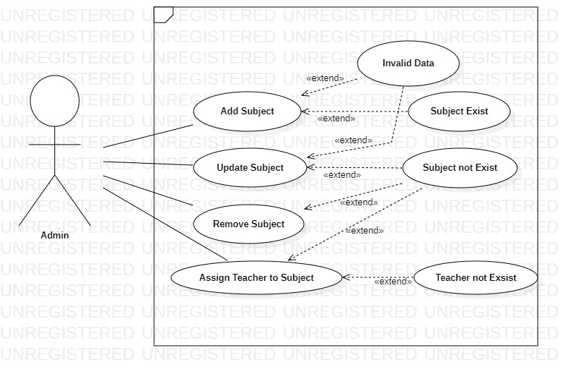
Use-Case Diagram cont.

Slide 10
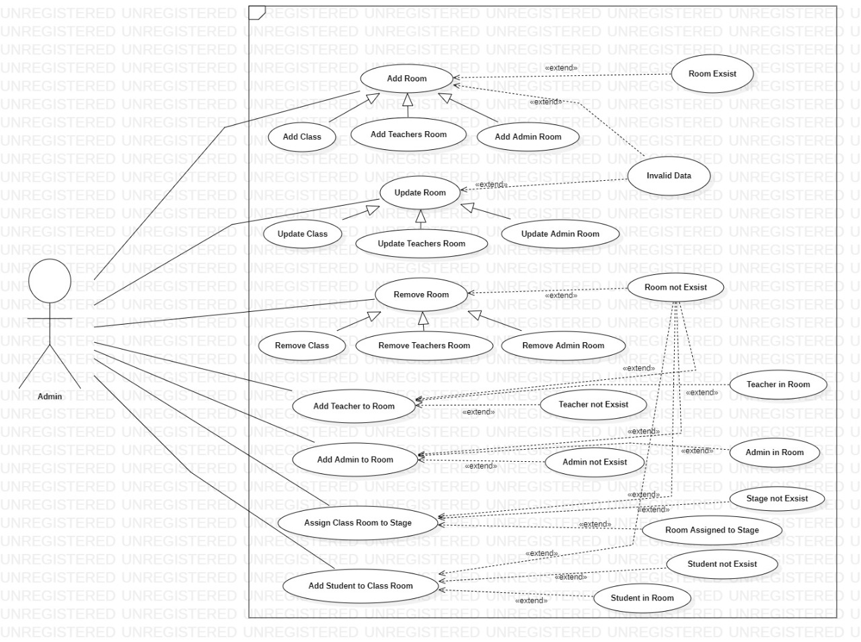
Use-Case Diagram cont.

Slide 11
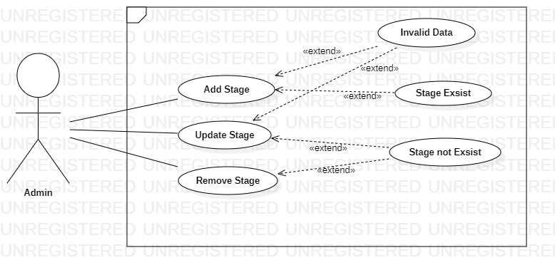
Use-Case Diagram cont.

Slide 12
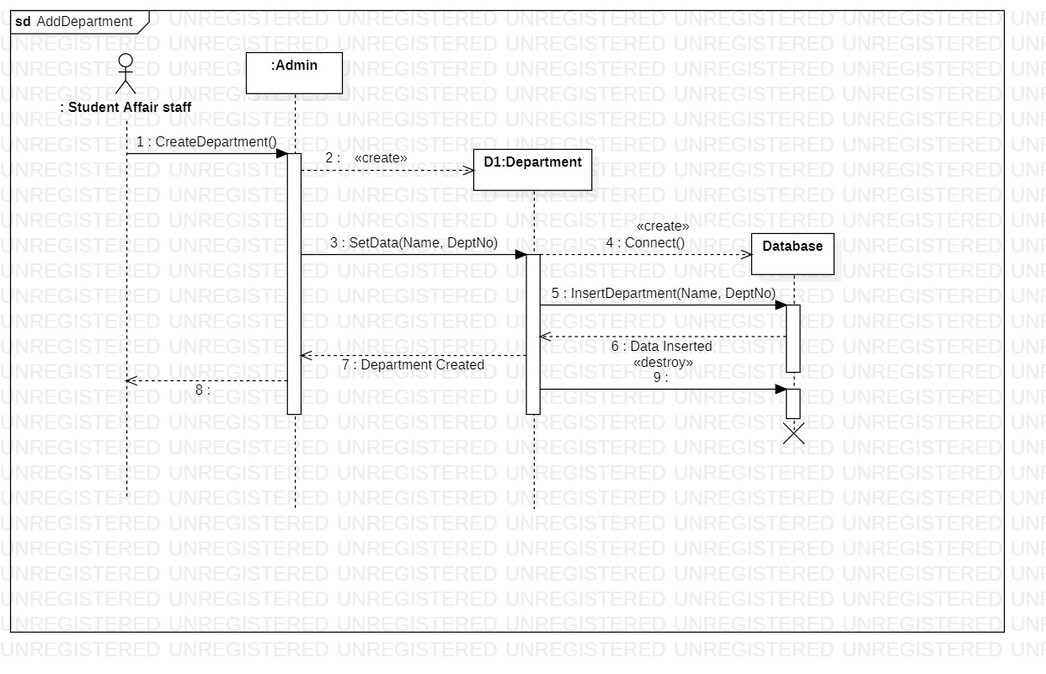
Sequence Diagram

Slide 13
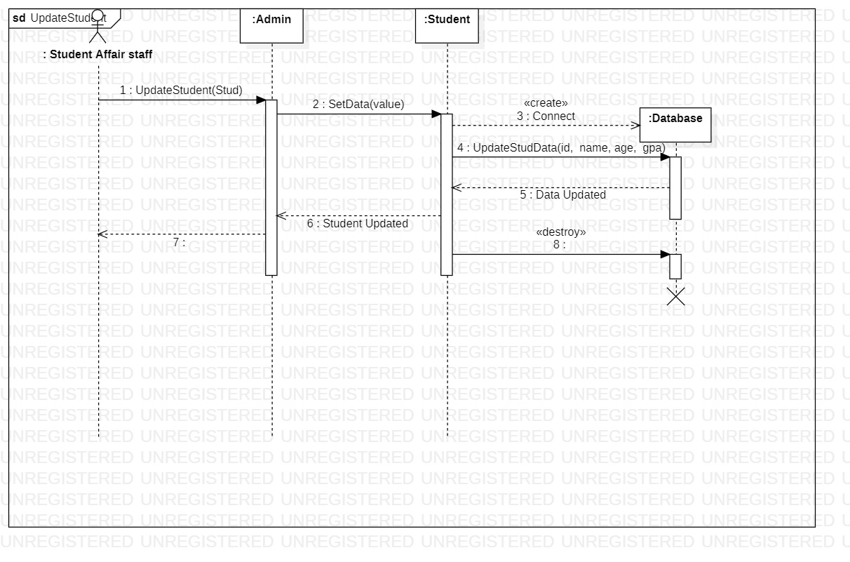
Sequence Diagram cont.

